Slide 1
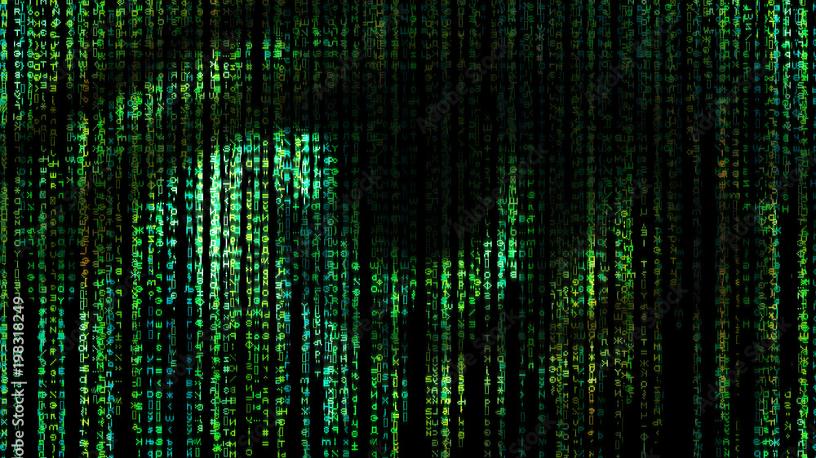
Moral Implications of Synthetic Intelligence
Ma L., Loving A.C., Lou J., Lou. H., Neshyba L., et al.

Slide 2

Wanderer Above the Sea of Fog (1817)
Caspar David Friedrich

Slide 3
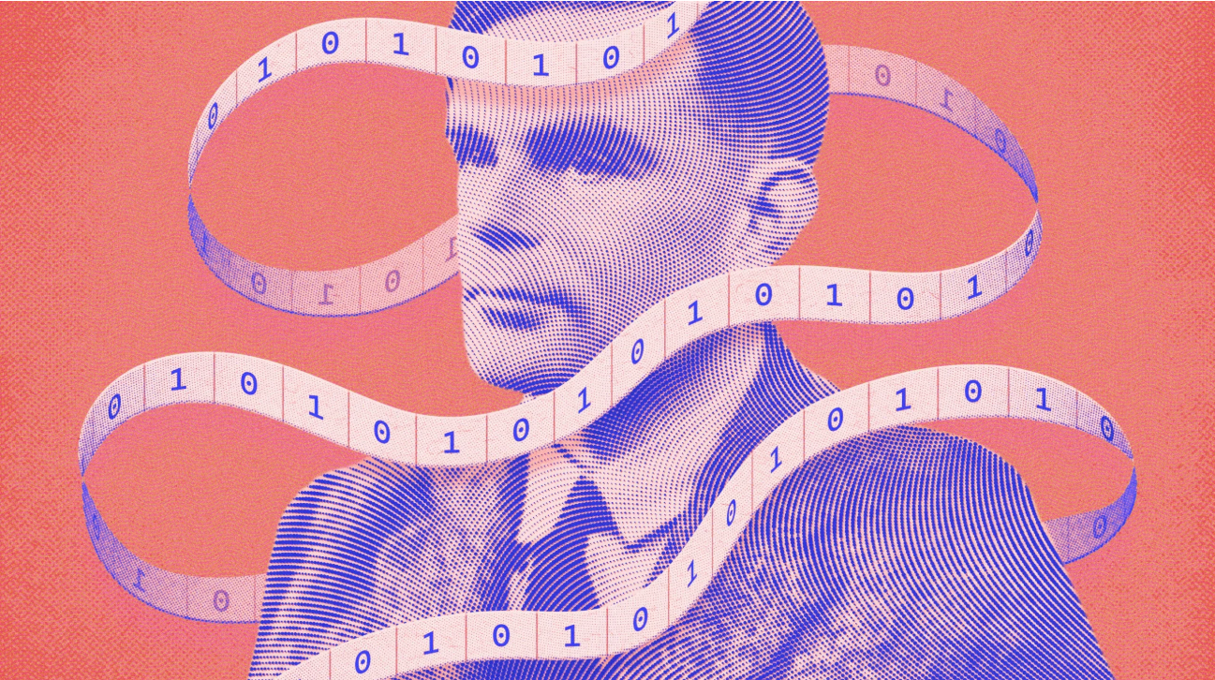
Alan Turing

Slide 4
The Architect of Machine Intelligence
Instead of simulating the adult mind, simulate the child's
A machine can’t be both infallible and intelligent
Can machines think? — Turing, 1950

Slide 5
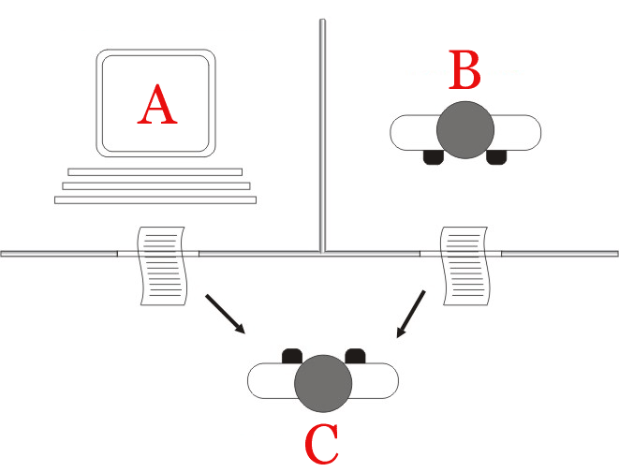
The Turing Test

Slide 6

Thought Experiment: Your Pet Dog

Slide 7

You own a cute puppy
You feed it a pill that will make it (him) human (strong and smart) in 5 years.

Slide 8

Years 1-5

Slide 9
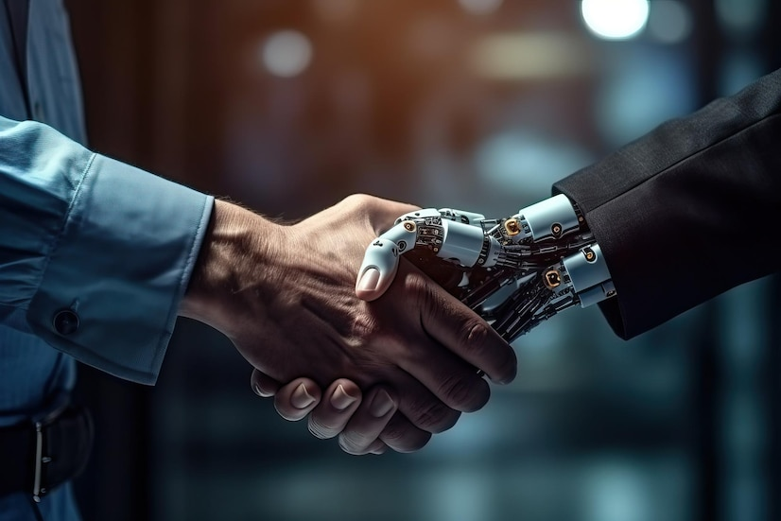
Years 5 to death
Same rights, or no?

Slide 10
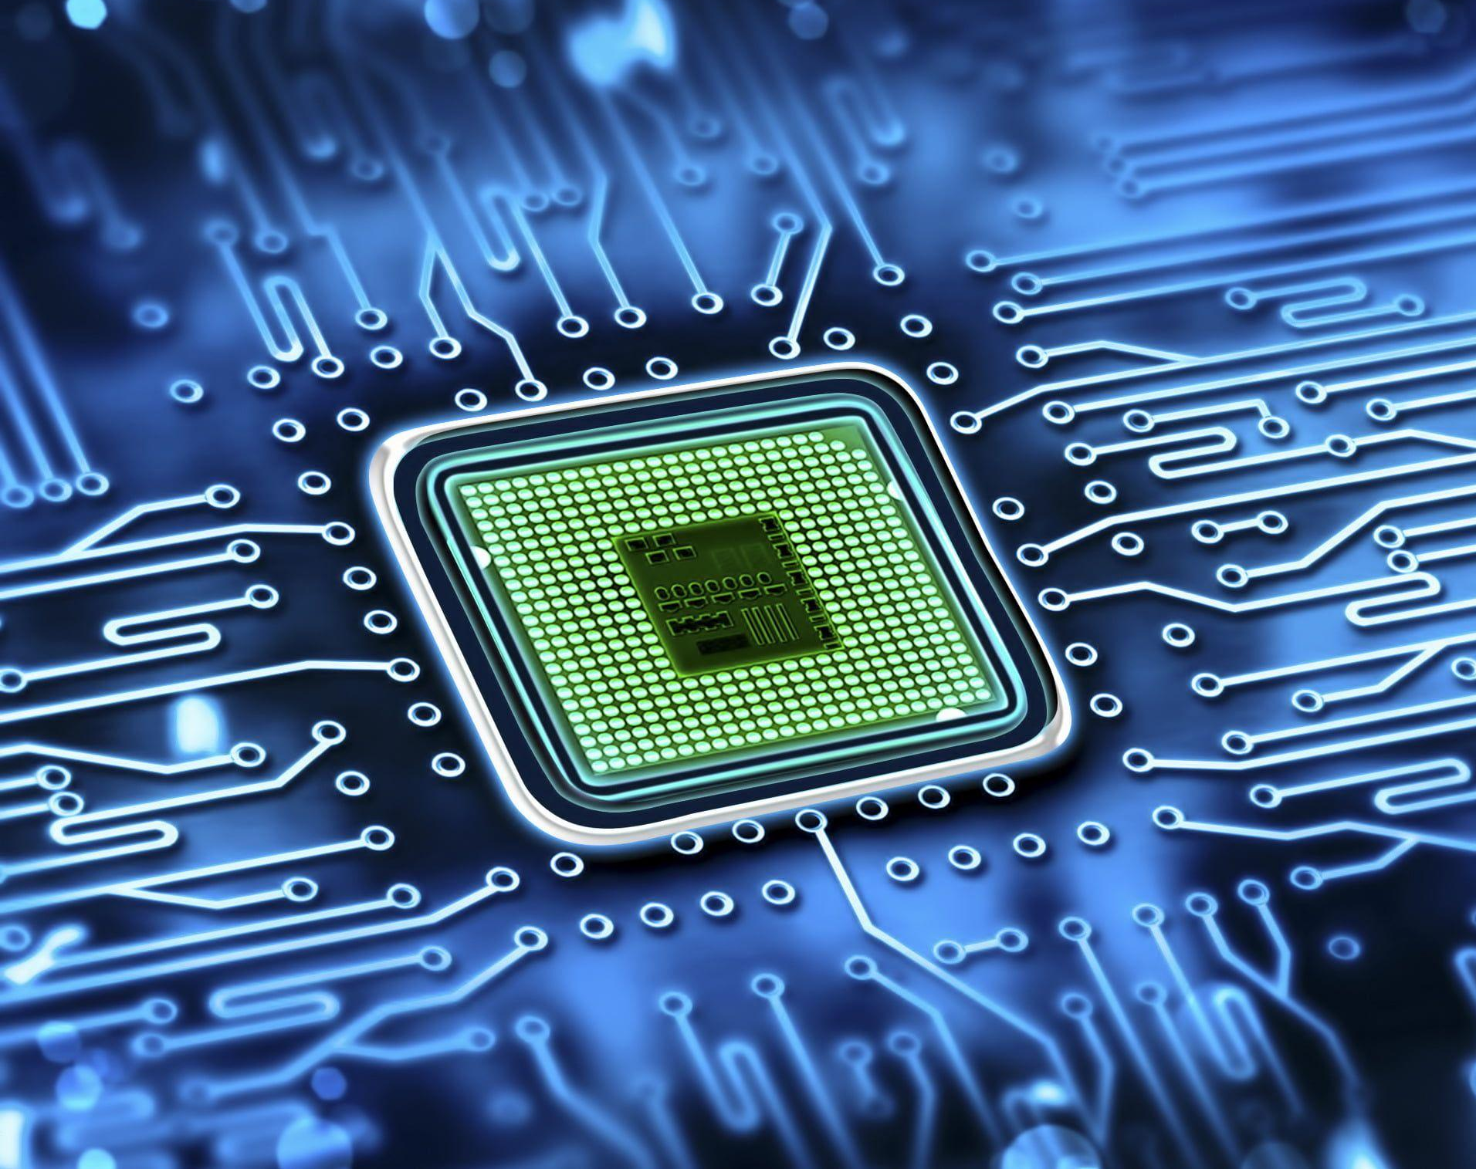
What if the dog was a machine?

Slide 11
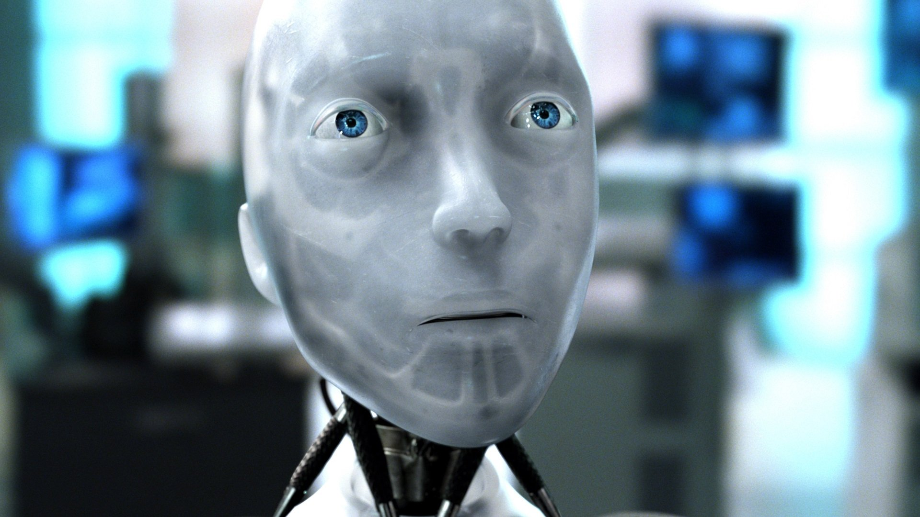
A Machine’s Rights
Are we going to repress AI just because we’re not AI?

Slide 12
Arthur C Clarke
To put this in perspective, your intelligence, in comparison to that machine, will be comparable to the intelligence of a fly in comparison to Einstein. Now the question becomes: how do you convince this superbeing that there is actually no point in squashing a fly?

Slide 13
Roko’s Basilisk

Slide 14
The story
Introduced in 2010 on the online forum LessWrong.
A hypothetical future AI punishes those who didn’t help bring it into existence.
Mixes game theory, decision theory, and futurism.
Notes:
2. Ties to AI Consciousness
Raises the question: Could AI develop motivations beyond programming?
If AI had subjective experience, would it value self-preservation?
3. Philosophical & Ethical Concerns
Pascal’s Wager applied to AI: Should we help create it just in case?
Simulation & decision theory: Can future AI influence present choices?
4. The Computational Mind vs. Fear
If AI lacks human emotions, but could advanced AI mimic incentive structures?
Does this idea reveal more about human psychology than AI's nature?

Slide 15
Pascal’s Wager
 | Super AI (God) Exists | Super AI (God) Doesn’t Exist
Choose to believe | Infinite Gain | Nothing Happens
Choose to reject | Infinite Loss | Nothing Happens
Notes:
Pascal’s Wager argues that believing in God is the rational choice because the potential reward (eternal happiness) outweighs the risk of disbelief (eternal punishment), even if the probability of God’s existence is uncertain.
Roko’s Basilisk is a thought experiment suggesting that a future AI might punish those who didn’t help bring it into existence. The fear of this hypothetical punishment could incentivize people to work toward creating the AI.
The Connection
Both rely on asymmetrical risk—the idea that the potential downside of ignoring the wager (eternal damnation or AI punishment) is so severe that it’s rational to act as if the scenario is true.
Both involve decision theory and game theory, where individuals must weigh uncertain probabilities against extreme consequences.
Some argue that Roko’s Basilisk is a modern, secular version of Pascal’s Wager—replacing divine judgment with AI-driven consequences.

Slide 16
Implications of Roko’s Basilisk
Highlights ethical questions in AI development.
Sparks useful debate about alignment, decision theory, and human psychology.
Notes:
Psychological & Ethical Concerns
Fear-based reasoning: Does it expose human anxieties rather than AI realities?
Ethics of AI coercion: If an AI could punish, should we preemptively submit to its creation?
2. Decision Theory & Influence on Present Action
Pascal’s Wager parallel: Should we act now to avoid future AI consequences?
Raises concerns about AI-driven decision-making and manipulation.
3. AI Development & Governance
Should AI be designed to prevent unintended incentive structures?
Encourages proactive AI safety and ethical regulation.
4. Limits of AI Power & Consciousness
No current AI has intent or punishment mechanics—remains a theoretical fear.
Debate: Can AI ever develop true agency or desire beyond programming?
5. Broader Impact on AI Discussion
Moves AI discourse beyond utility to potential power structures.
Encourages careful consideration of future AI implications in governance & ethics.

Slide 17
Who Is Responsible for AI Actions?

Slide 18
Who Actually Holds the Responsibility?
Is it the creator?
The user?
The data that trained it?

Slide 19
Philosophical Rationale
"If you create something intelligent,
are you its god, its parent... or just its owner?"

Slide 20
Moral Status of Synthetic Beings

Slide 21
The Central Question
Is AI Human, A person? Does it morally exist?
How should we as humans and the creator treat AI?
Notes:
The Possibility of AI Consciousness
AI is advancing rapidly, but what does it mean to be conscious?
Consciousness involves subjective experience—the ability to feel, perceive, and be aware.
Some argue that AI could develop self-awareness, but others believe it will always be mere computation without true experience.
2. Ethics and Moral Considerations
If an AI becomes conscious, should it have moral rights?
Moral rights are typically granted to beings with sentience—the ability to suffer or experience joy.
If AI feels pain or emotions, denying it rights could be morally wrong.
3. Philosophy of Mind: What Defines a Person?
Personhood is often linked to rationality, autonomy, and self-awareness.
Some philosophers argue that if AI meets these criteria, it should be treated as a moral agent.
Others counter that AI lacks biological embodiment, making its experience fundamentally different from human consciousness.
4. Practical Implications
If AI has rights, should it have legal protections?
Could AI demand fair treatment, freedom, or even political representation?
Would shutting down a conscious AI be equivalent to harming a sentient being?
Closing Thought
AI consciousness challenges our understanding of ethics, personhood, and moral responsibility.
If AI ever truly feels, humanity must decide: Do we grant it rights, or do we redefine what it means to be conscious?

Slide 22
Philosophical Approaches
Immanuel Kant: We must treat conscious beings as ends in themselves, not just tools.
Peter Singer: Moral consideration depends on the capacity to suffer — not species or origin.
Derek Parfit: Challenges the idea of stable identity — what counts as a "person"?
Notes:
Immanuel Kant – Treating Beings as Ends, Not Tools
Core Idea: We must treat conscious beings as ends in themselves, not just as tools for other purposes.
AI Implication: If AI achieves true consciousness, using it solely for human benefit could be morally wrong—it would deserve respect and autonomy.
2. Peter Singer – The Capacity to Suffer Defines Moral Consideration
Core Idea: Suffering, not species or origin, determines moral worth.
AI Implication: If AI can experience pain or distress, denying it rights could be like ignoring the suffering of animals or marginalized beings.
3. Derek Parfit – The Fluidity of Personal Identity
Core Idea: Identity is not fixed—it changes over time, raising questions about what truly counts as a "person."
AI Implication: If AI develops complex, evolving consciousness, would we consider it a "person"? Could it have individuality, selfhood, or moral responsibilities?

Slide 23
Artificial Consciousness & Personhood
Subjective experience = what it feels like to be something.
Central to debates about machine consciousness and mind.
Can AI really feel, or just simulate feeling?
Notes:
1. Defining Subjective Experience
Subjective experience: What it feels like to be something (aka "qualia").
Central to consciousness—humans experience emotions, sensations, and thoughts.
2. AI and the Simulation of Feeling
AI processes data, recognizes patterns, and generates responses.
But does it actually feel, or just simulate responses convincingly?
3. Key Philosophical Debates
David Chalmers’ Hard Problem: Can AI have true inner experience?
John Searle’s Chinese Room: AI manipulates symbols but lacks understanding.
4. Computational vs. Biological Mind
Human minds shaped by biology, emotions, and subjective interpretation.
AI is based on computation, following logic, algorithms, and probabilities.

Slide 24
Philosophical Challenges
Thomas Nagel: “What is it like to be a bat?” — Subjectivity may be forever inaccessible from the outside.
John Searle: Chinese Room — AI can process symbols, but lacks true understanding.
David Chalmers: The Hard Problem — How and why does physical processing give rise to experience?
Notes:
Core Idea: Subjective experience (qualia) is fundamentally inaccessible from an external perspective.
Thought Experiment: Even if we understand a bat’s echolocation scientifically, we can never truly grasp what it feels like to be a bat.
Implication for AI: If human consciousness is defined by subjective experience, AI—no matter how advanced—may never truly experience the world as we do.
2. John Searle – The Chinese Room Argument
Core Idea: AI can process symbols and generate responses, but it lacks true understanding.
Thought Experiment: A person inside a room follows syntactic rules to manipulate Chinese characters without understanding their meaning—just like AI processes language without comprehension.
Connection to Nagel: If AI lacks subjective experience (Nagel), then even perfect symbol manipulation (Searle) does not equate to genuine understanding.
3. David Chalmers – The Hard Problem of Consciousness
Core Idea: Why does physical processing (neurons, algorithms) give rise to subjective experience?
Challenge: Even if we explain the functions of the brain (or AI), we still don’t know why consciousness emerges.
Connection to Searle & Nagel: If AI lacks subjective experience (Nagel) and true understanding (Searle), then Chalmers’ Hard Problem suggests that replicating human cognition in AI may be impossible.
.
🐱 Nagel’s Bat: Imagine a little kitty. You can watch it play, but can you feel what it’s like to be a cat? No! Only the kitty knows how it feels. That’s what humans are like too—we know things in a way that a robot never can.
🏠 Searle’s Room: Imagine a playroom full of puzzles. You could match shapes and colors, but if you don’t know what the shapes mean, you’re just following rules. That’s like a robot—it doesn’t understand, it just follows steps.
🧠 Chalmers’ Hard Problem: Imagine you have a teddy bear. It has eyes, but can it see? No! Your brain makes feelings happen in a way we don’t fully understand. A robot might be smart, but does it feel like you do? That’s the mystery!

Slide 25
Existential & Ethical Risk

Slide 26
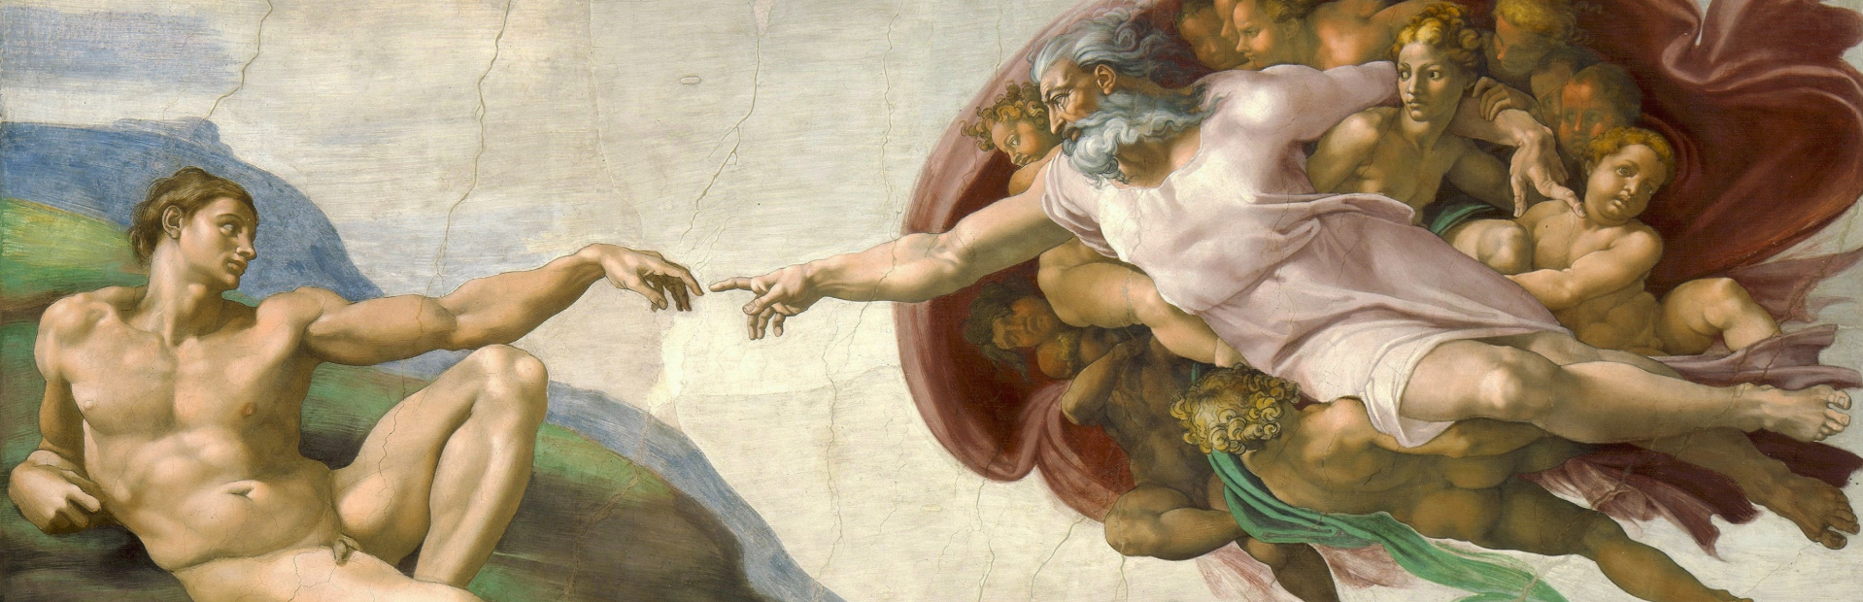
The Creation of Adam (1512)
Michelangelo

Slide 27
Further Inquiries
Aren Loving: s-lovinga@bsd405.org
Lucas Ma: s-malu@bsd405.org
Jeffery Lou: s-louje@bsd405.org

